Slide 1

Abdul Azeez
July 13, 2024

Slide 2

Outline
Executive Summary
Introduction
Methodology
Results
Conclusion

Slide 3
Summary of methodologies Summary of all results
Executive Summary
In this capstone project, we will predict if the SpaceX Falcon 9 first stage will land successfully using several machine learning classification algorithms.
The main steps in this project include:
• Data collection, wrangling, and formatting
• Exploratory data analysis
• Interactive data visualization
• Machine learning prediction
Our graphs show that some features of the rocket launches have a correlation with the outcome of the launches, i.e., success or failure.
It is also concluded that decision tree may be the best machine learning algorithm to predict if the Falcon 9 first stage will land successfully

Slide 4
Introduction
Project background and context
SpaceX, A leader in the space industry strives to make space travel affordable for everyone. It’s accomplishments include sending spacecraft to the International Space Station, launching a satellite constellation that provides Internet access and sending manned missions to space. SpaceX can do this because the rocket launches are relatively inexpensive ($62 million per launch) due to its novel reuse of the first stage of its Falcon 9 rocket other providers which are not able to reuse the first stage cost upwards of $165 million each. By determining if the first stage will land, we can determine the price of the launch. To do this, we can use public data and machine learning models to predict whether SpaceX - or a competing company - can reuse the first stage.
Problems you want to find answers
How payload mass, launch site, number of flights, and orbits abstract first stage landing success
Rate of successful landings overtime
Best predictive model for successful landing (binary classification]

Slide 5


Slide 6
Methodology
Executive Summary
Data collection methodology:
Using SpaceX REST API
Using web scrapping from Wikipedia
Perform data wrangling
Filtering the data
Dealing with missing values
Using One Hot Encoding to prepare the data to a binary classification
Perform exploratory data analysis (EDA) using visualization and SQL
Perform interactive visual analytics using Folium and Plotly Dash
Perform predictive analysis using classification models
Building, tuning and evaluation of classification models to ensure the best results

Slide 7
Data Collection
Describe how data sets were collected.
Data Collection process involved a combination of API requests from SpaceX REST API and Web Scraping data from a table in SpaceX’s Wikipedia entry.
We had to use both of these data collection method in order to get complete information about the launches for a more detailed analysis.
Data Columns are obtained by using SpaceX REST API:
FlightNumber, Date, BoosterVersion, PayloadMass, Orbit, LaunchSite, Outcome, Flight, GridFins Reused, Legs, LandingPad, Block, ReusedCount, Serial, Longitude, Latitude.
Data Columns Auto obtained by using Wikipedia Web Scraping:
Flight No., Launch site, Payload, PayloadMass, Orbit, Customer, Launch outcome, Version Booster, Booster Landing, Date, Time.

Slide 8
Data Collection – SpaceX API
Requesting rocket launch data from SpaceX API
Decoding the response content using .json() & turning it into a dataframe using .json_normalize()
Requesting needed information about the launches from SpaceX API by applying custom functions
Constructed data we have obtained into a dictionary
Exporting the data to CSV
Replacing missing values of Payload Mass column with calculated .mean() for this column
Filtering the dataframe to only include Falcon 9 launches
Creating a dataframe from the dictionary
Add the GitHub URL of the completed SpaceX API calls notebook (must include completed code cell and outcome cell), as an external reference and peer-review purpose

Slide 9
Data Collection - Scraping
Requesting Falcon 9 launch data from Wikipedia
Creating a BeautifulSoup object from the HTML response
Extracting all column names from HTML table header
Collecting the data by parsing HTML tables
Exporting the data to CSV
Creating a dataframe from the dictionary
Constructing data we have obtained into a dictionary
Add the GitHub URL of the completed web scraping notebook, as an external reference and peer-review purpose

Slide 10
Data Wrangling
Describe how data were processed
Initially some Exploratory Data Analysis was performed on the dataset
Then the summaries launches per site, occurrences of each orbit and occurrences of mission outcome per orbit type were calculated.
Finally, the landing outcome label was created from Outcome column.
Add the GitHub URL of your completed data wrangling related notebooks, as an external reference and peer-review purpose
Exploratory Data Analysis
Summarizations
Creation of Landing Outcome Label

Slide 11
EDA with Data Visualization
Summarize what charts were plotted and why you used those charts
Flight Number vs. Payload Mass, Flight Number vs. Launch Site, Payload Mass vs. Launch Site, Orbit Type vs. Success Rate, Flight Number vs. Orbit Type, Payload Mass vs. Orbit Type and Success Rate Yearly Trend.
Scatter plots show the relationship between variables. If a relationship exists, they could be used in machine learning model.
Bar charts show comparisons among discrete categories. The goal is to show the relationship between the specific categories being compared and a measured value.
Line charts show trends in data over time [time series].
Add the GitHub URL of your completed EDA with data visualization notebook, as an external reference and peer-review purpose

Slide 12
EDA with SQL
Using bullet point format, summarize the SQL queries you performed
Displaying name of the unique launch files in the space mission.
Displaying file records where launch sites begin with the string ‘CCA’.
Displaying total payload mass carried by boosters launched by NASA (CRS).
Displaying average payload mass carried by booster version F9 v1.1.
Listing the day when the first successful landing outcome in ground pad was achieved.
Listing names of boosters which have success in drone ship & have payload mass > 4000 but < 6000.
Listing total number of successful and failure mission outcomes.
Listing names of booster versions which have carried maximum payload mass.
Listing failed landing outcomes in drone ship, their booster versions & launch site names for months in 2015.
Ranking the count of landing outcomes [such as Failure [drone ship] or Success [Ground pad]] between the date 2010-06-04 & 2017-03-20 in descending order.
Add the GitHub URL of your completed EDA with SQL note in the space mission. book, as an external reference and peer-review purpose

Slide 13
Build an Interactive Map with Folium
Markers Indicating Launch Sites
Added Blue Circle at NASA Johnson Space Center’s coordinate with a pop up label showing its name using its latitude and longitude coordinates.
Added Red Circles at all launch sites coordinates with a pop up label showing its name using its latitude and longitude coordinates.
Colored Markers of Launch Outcomes
Added colored markers of successful [green] and unsuccessful [red] launches at each launch site to show which launch sites have high success rates.
Distances between a Launch Site to Proximities
Added colored lines to show distance between launch site CCAFS SLC – 40 and its proximity to the nearest coastline, railway, highway, and city.
Add the GitHub URL of your completed interactive map with Folium map, as an external reference and peer-review purpose

Slide 14
Build a Dashboard with Plotly Dash
Launch Sites Dropdown List:
Added a dropdown list to enable Launch Site selection.
Pie Chart showing Success launches (All Sites/Certain Site):
Added a pie chart to show the total successful launches count for all sites and the Success vs. Failed counts for the site, if a specific Launch Site was selected.
Slider of Payload Mass Range:
Added a slider to select Payload range.
Scatter Chart of Payload Mass vs. Success Rate for the different Booster Versions:
Added a scatter chart to show the correlation between Payload and Launch Success
Add the GitHub URL of your completed Plotly Dash lab, as an external reference and peer-review purpose

Slide 15
Predictive Analysis (Classification)
Create a NumPy array from the column “Class” in data
Standardizing the data with StandardScaler, then fitting and transforming it
Splitting the data into training and testing sets with train_test_split function
Creating a GridSearchCV object with cv = 10 to find the best parameters
Add the GitHub URL of your completed predictive analysis lab, as an external reference and peer-review purpose
Finding the method that performs best by examining the Jaccard_score and F1_score metrics
Examining the confusion matrix for all models
Calculating the accuracy on the test data using the method .score() for all models
Applying GridSearchCV on LogReg, SVM, Decision Tree, and KNN models

Slide 16
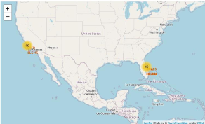
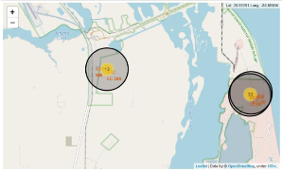
Results
Exploratory data analysis results
Launch success has improved over time.
KSC LC-39A has the highest success rate among landing sites.
Orbits ES-L1, GEO, HEO and SSO have a 100% success rate.
Interactive analytics demo in screenshots
Predictive analysis results
Decision Tree model is the best predictive model for the dataset.

Slide 17

Section 2

Slide 18
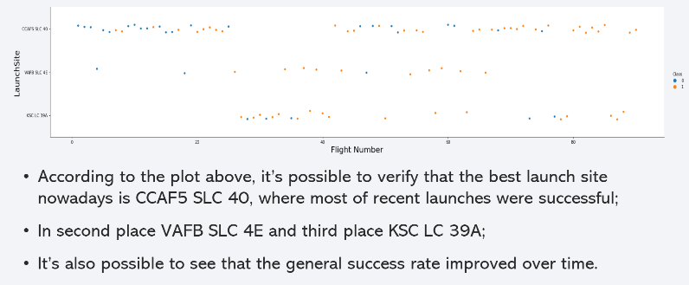
Flight Number vs. Launch Site

Slide 19
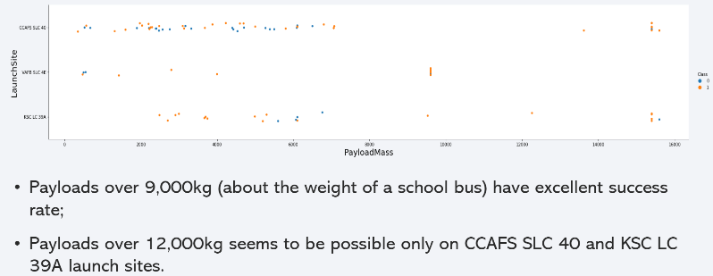
Payload vs. Launch Site

Slide 20
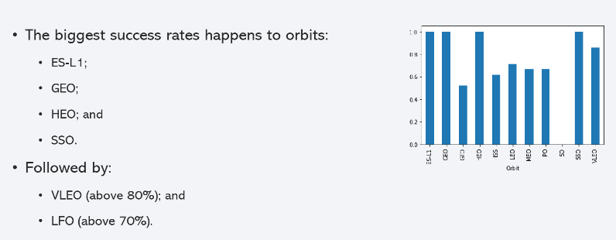
Success Rate vs. Orbit Type
Show a bar chart for the success rate of each orbit type
Show the screenshot of the scatter plot with explanations

Slide 21
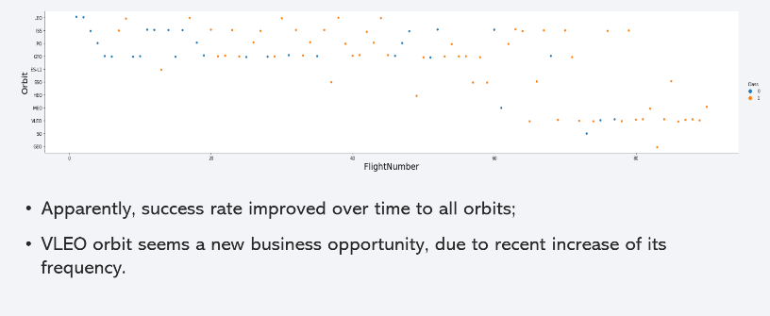
Flight Number vs. Orbit Type
Show a scatter point of Flight number vs. Orbit type
Show the screenshot of the scatter plot with explanations

Slide 22
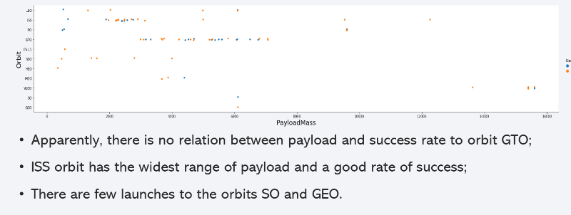
Payload vs. Orbit Type
Show a scatter point of payload vs. orbit type
Show the screenshot of the scatter plot with explanations

Slide 23
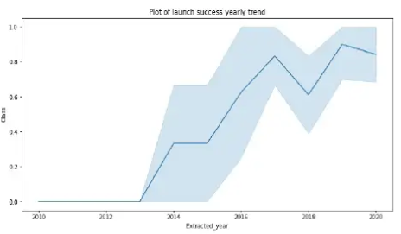
Launch Success Yearly Trend
Show a line chart of yearly average success rate
From this plot we can observe that success rate since 2013 kept on increasing till 2020.

Slide 24
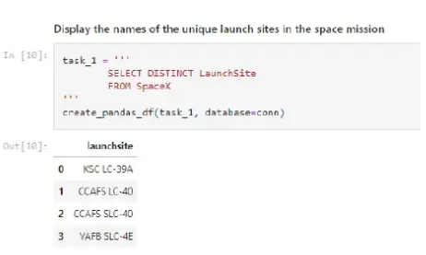
All Launch Site Names
Find the names of the unique launch sites
We used the key word DISTINCT to show only unique launch sites from the SpaceX data.

Slide 25
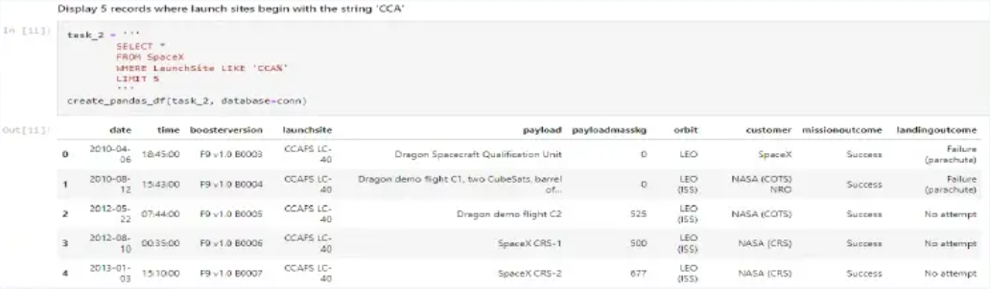
Launch Site Names Begin with 'CCA'
We used the above query to display 5 records where launch sites begin with ‘CCA’.

Slide 26
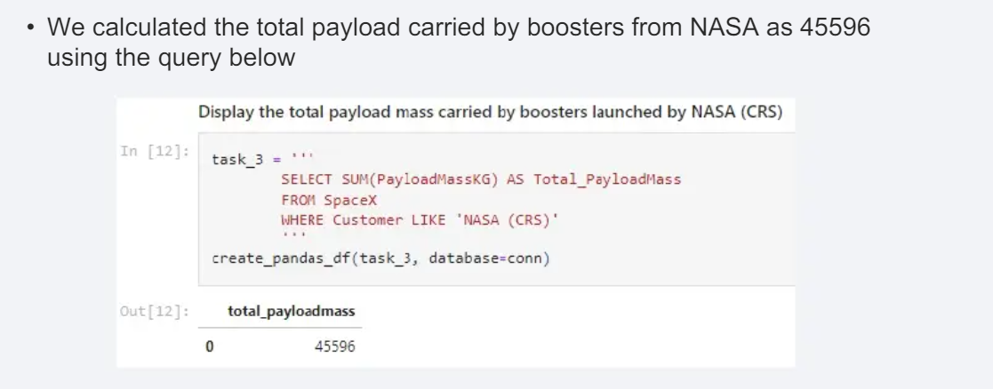
Total Payload Mass
Calculate the total payload carried by boosters from NASA
Present your query result with a short explanation here

Slide 27
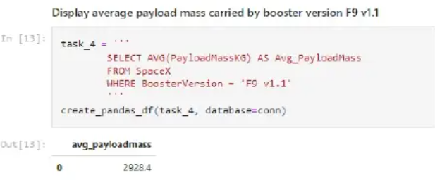
Average Payload Mass by F9 v1.1
We calculated the average payload mass carried by booster version F9 v1.1

Slide 28
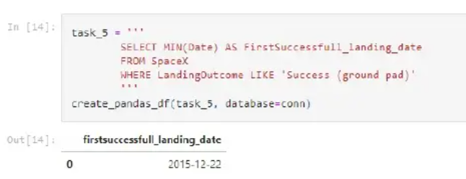
First Successful Ground Landing Date
Find the dates of the first successful landing outcome on ground pad
Present your query result with a short explanation here

Slide 29
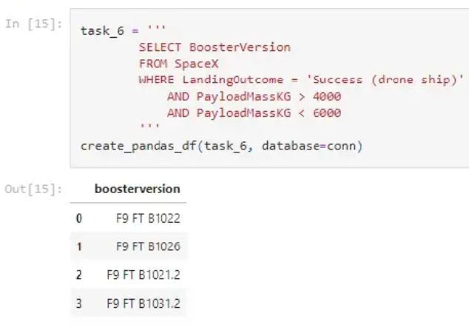
Successful Drone Ship Landing with Payload between 4000 and 6000
List the names of boosters which have successfully landed on drone ship and had payload mass greater than 4000 but less than 6000

Slide 30
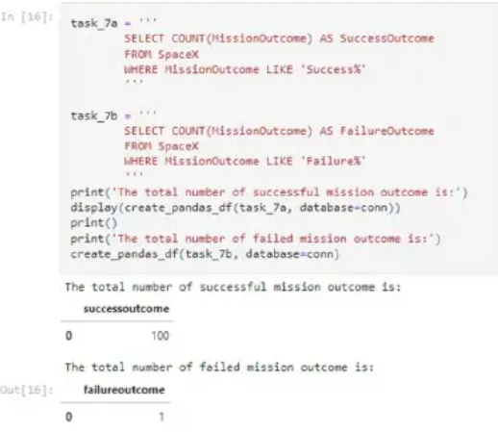
Total Number of Successful and Failure Mission Outcomes
Calculate the total number of successful and failure mission outcomes

Slide 31
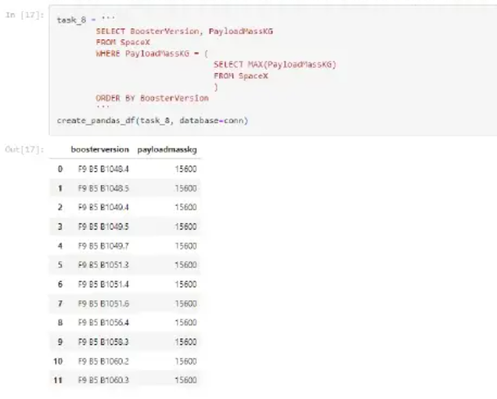
Boosters Carried Maximum Payload
List the names of the booster which have carried the maximum payload mass

Slide 32
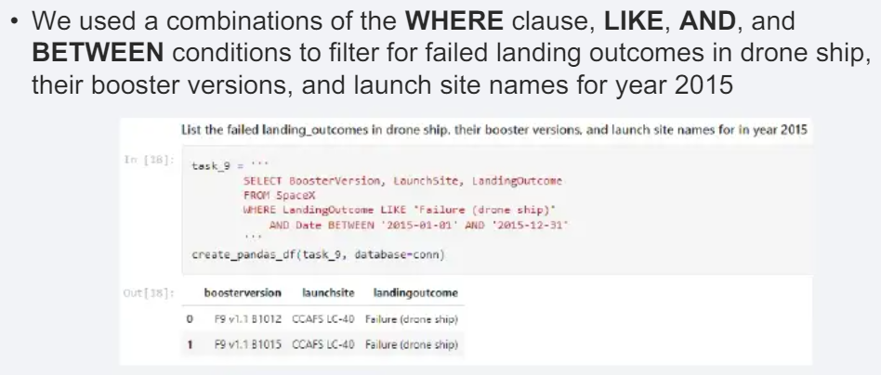
2015 Launch Records
List the failed landing_outcomes in drone ship, their booster versions, and launch site names for in year 2015
Present your query result with a short explanation here

Slide 33
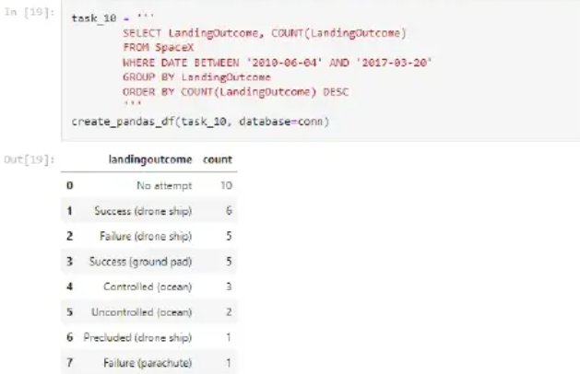
Rank Landing Outcomes Between 2010-06-04 and 2017-03-20
Rank the count of landing outcomes (such as Failure (drone ship) or Success (ground pad)) between the date 2010-06-04 and 2017-03-20, in descending order

Slide 34

Section 3

Slide 35

All Launch Sites global map markets
Replace <Folium map screenshot 1> title with an appropriate title
Explore the generated folium map and make a proper screenshot to include all launch sites’ location markers on a global map
Explain the important elements and findings on the screenshot

Slide 36
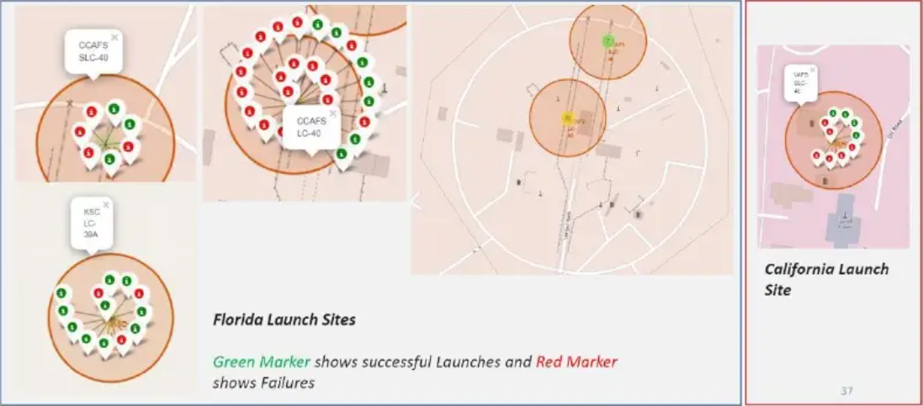
Markers showing Launch Sites with color labels
Replace <Folium map screenshot 2> title with an appropriate title
Explore the folium map and make a proper screenshot to show the color-labeled launch outcomes on the map
Explain the important elements and findings on the screenshot

Slide 37
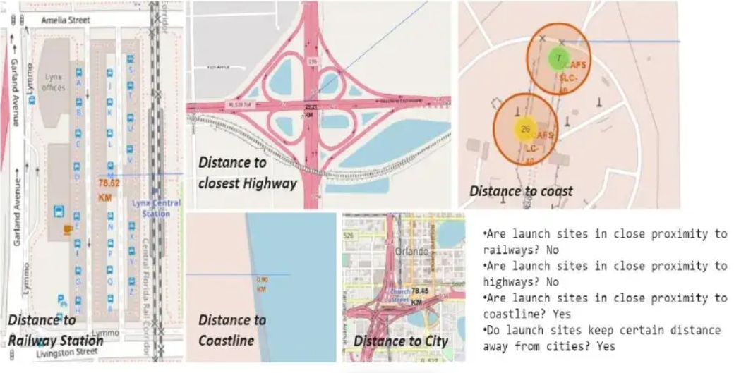
Launch Site distances to Landmarks
Replace <Folium map screenshot 3> title with an appropriate title
Explore the generated folium map and show the screenshot of a selected launch site to its proximities such as railway, highway, coastline, with distance calculated and displayed
Explain the important elements and findings on the screenshot

Slide 38

Section 4

Slide 39
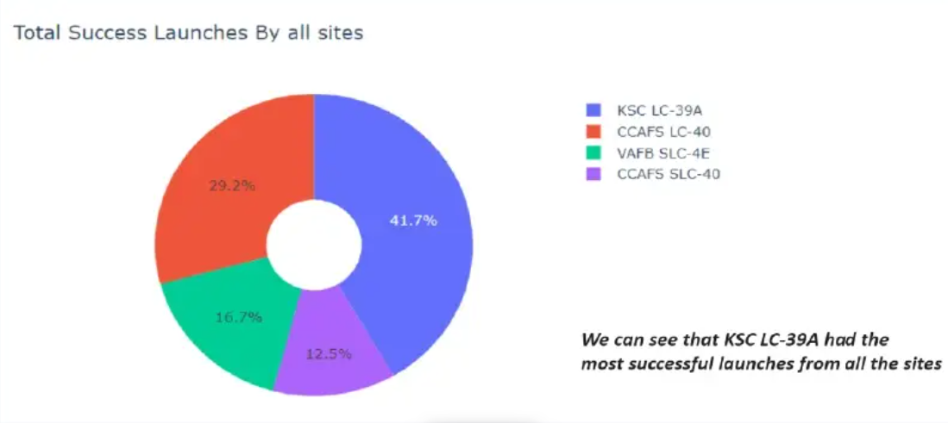
Pie Chart showing success rate achieved by each Launch Site
Replace <Dashboard screenshot 1> title with an appropriate title
Show the screenshot of launch success count for all sites, in a piechart
Explain the important elements and findings on the screenshot

Slide 40
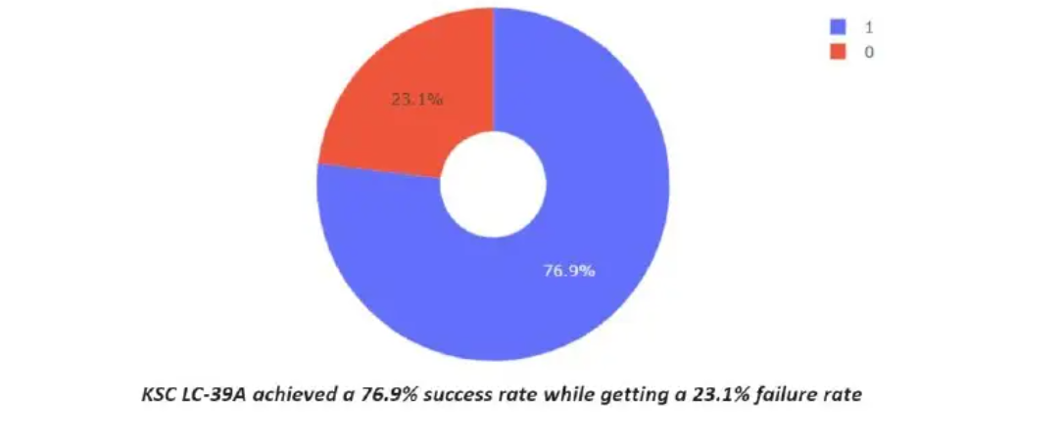
Pie Chart showing the Launch Site with the highest launch success ratio
Replace <Dashboard screenshot 2> title with an appropriate title
Show the screenshot of the piechart for the launch site with highest launch success ratio
Explain the important elements and findings on the screenshot

Slide 41
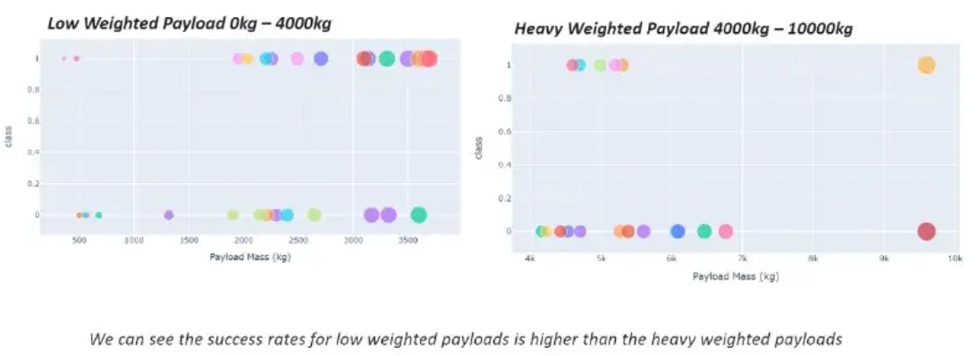
Scatter Plot of PayLoad vs Launch Outcome for all sites with different payload selected by range slider
Replace <Dashboard screenshot 3> title with an appropriate title
Show screenshots of Payload vs. Launch Outcome scatter plot for all sites, with different payload selected in the range slider
Explain the important elements and findings on the screenshot, such as which payload range or booster version have the largest success rate, etc.

Slide 42

Section 5

Slide 43
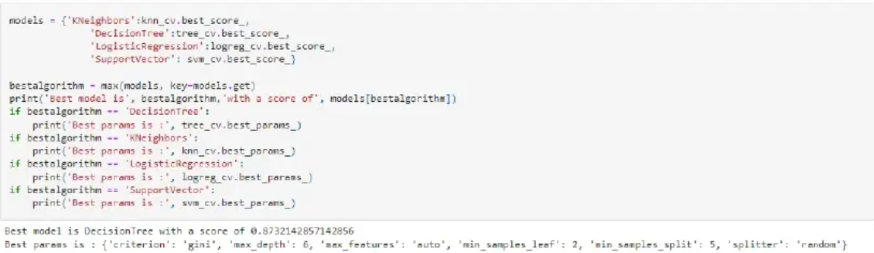
Classification Accuracy
The DecisionTree classifier is the model with the highest classification accuracy

Slide 44
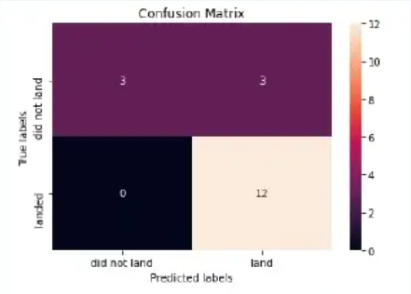
Confusion Matrix
The confusion matrix of the best performing model with an explanation
The confusion matrix for the DecisionTree classifier shows that the classifier can distinguish between the different classes. The major problem is the false positives .i.e., unsuccessful landing marked as successful as the classifier.

Slide 45
Conclusions
We can conclude that
The larger the flight amount at a launch site, he greater the success rate at a lunch sie.
Launch success rate started to increase in 2013 till 2020.
Orbits ES-L1, GEO, HEO, SSO, VLEO had the most success rate.
KSC LC-39A had the most successful launches of any sites.
The DecisionTree classifier is the best machine learning algorithm for the task

Slide 46


